Slide 1
Bootcamp 2020
Final Project
Miguel Angel Cabrera Miñagorri
14/02/2020

Slide 2
Introduction
Docker image
Helm Chart
Deliverables
Hints

Slide 3
Introduction
Comprehensive Knowledge Archive Network (CKAN)

Slide 4
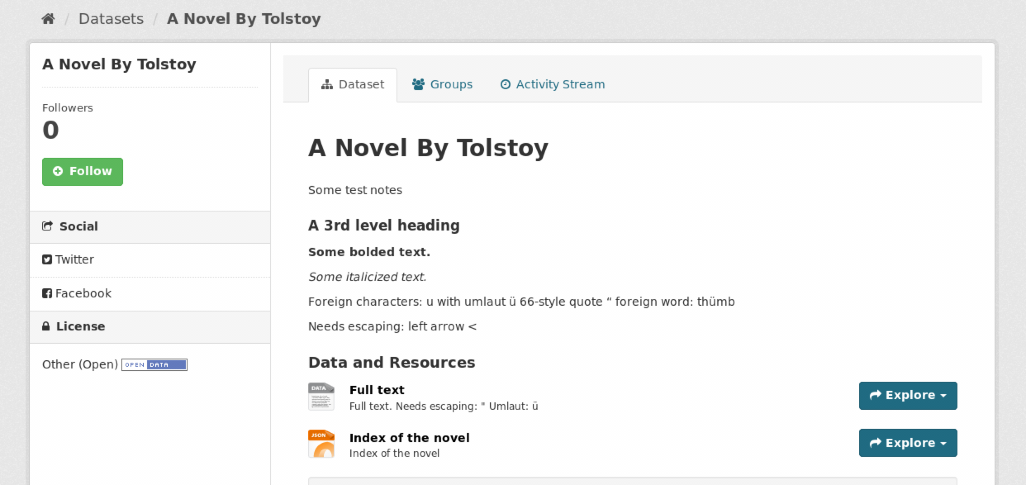
The goal of the final project is to create a CKAN Helm Chart
Like a CMS, but for data

Slide 5
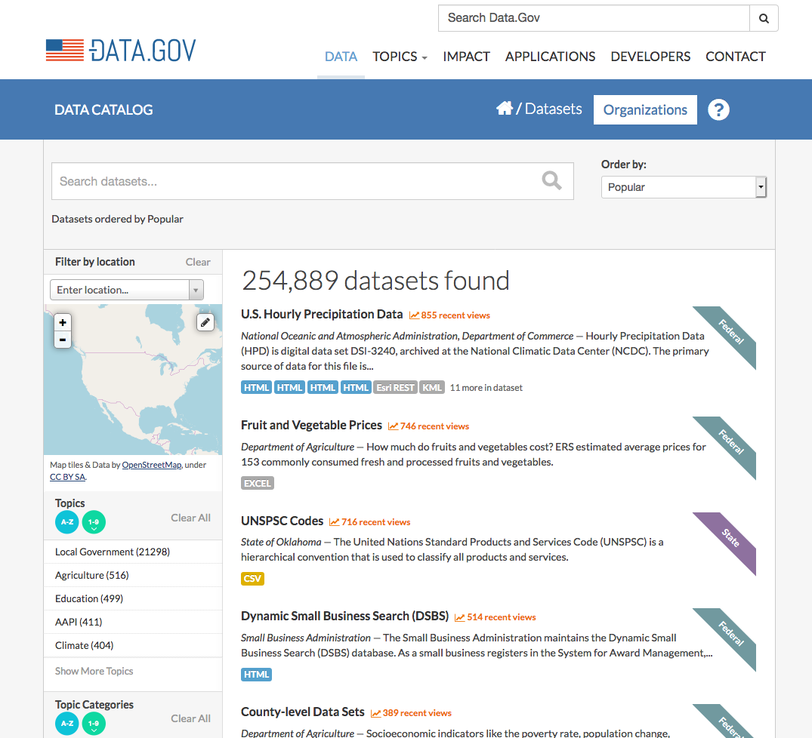
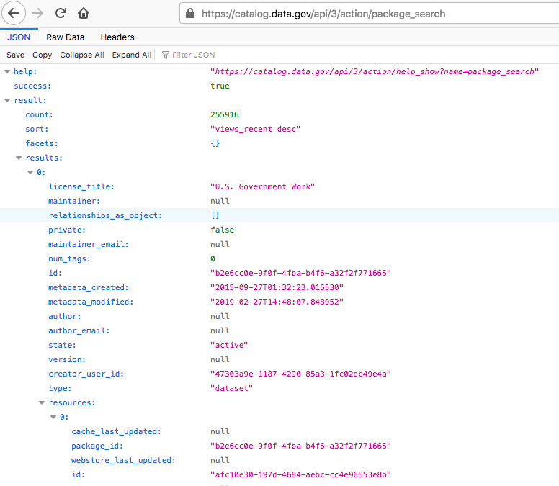
Who uses CKAN?
Mainly public institutions

Slide 6
Docker image

Slide 7
Docker image
Requirements
Requirements:
Installation: Available from package and from source. ( We prefer from source )
Run as non-root user. ( UID: 1001 )
Follow bash and Dockerfile best practices.
Make optional to populate the PostgreSQL database on first run.
Manage resources persistence, they should persist between restarts. ( Volume )
Manage configuration persistence.

Slide 8
Docker image
Environment variables
Environment variables (at least):
CKAN_URL (or CKAN_HOST & CKAN_PORT)
CKAN_INITIALIZE_DB ( 'yes'/'no' )
CKAN_SITE_ID
CKAN_PLUGINS
CKAN_STORAGE_PATH ( for persistence requirement )
CKAN_CONF_PATH ( for persistence requirement )
CKAN_ADMIN
CKAN_ADMIN_EMAIL
CKAN_ADMIN_PASSWORD
POSTGRESQL_URL (or POSTGRESQL_HOST & POSTGRESQL_PORT)
POSTGRESQL_DATABASE_USER
POSTGRESQL_DATABASE_USER_PASSWORD
POSTGRESQL_DATASTORE_USER_PASSWORD
POSTGRESQL_DATASTORE_USER
POSTGRESQL_CKAN_DATABASE
POSTGRESQL_CKAN_DATASTORE
SOLR_URL (or SOLR_HOST & SOLR_PORT)
SOLR_CORE_NAME
REDIS_URL (or REDIS_HOST & REDIS_PORT)
REDIS_USER
REDIS_PASSWORD
OPTIONAL: MEMCACHED_URL & CKAN_BAKER_SESSION_SECRET
If you need more feel free to add them, there is no limit.
The more configuration capabilities the best.

Slide 9
Docker image
Debugging
For debugging purpose you will need to create a docker-compose file.
The following services are required:
CKAN
Redis
PostgreSQL
Solr (use the same image and command as the provided deployment)
Memcached ( Optional )

Slide 10
Helm Chart

Slide 11
Helm Chart
Requirements
Once you tested your image using docker-compose it is time to create the Helm Chart.
Requirements:
Expose options to configure at least, the required env vars in the docker image.
CKAN should run on port 5001 inside the pod ( use the env var to configure it ) and 80 by default in the service.
Use an Ingress for the web interface, enabled with ingress.enabled=true, otherwise it should be disabled.
Support ClusterIP/NodePort/LoadBalancer.
The NOTES.txt must provide instructions to connect to the application in each case.
Support three ways to configure the admin password:
Directly in the values.yaml or with --set.
If the password is not specified, the chart should generate a random one. ( And show in the notes how to obtain it)
Reuse an existing secret with the password.

Slide 12
Helm Chart
Requirements (II)
Support two ways for setting permissions in the persistent volumes:
Using init containers
Using kubernetes security context
Configurable Liveness and Readiness probes.
Make mandatory to provide the CKAN hostname, failing in case it is not provided.

Slide 13
Deliverables

Slide 14
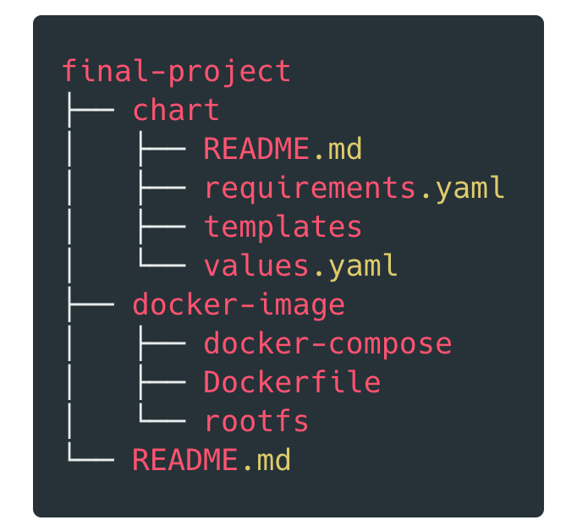
Deliverables
Send a PR to your private GitHub repository containing:
Inside the rootfs folder you can place any file you need to create your bash container.

Slide 15
Hints

Slide 16
Hints
We provide you with the Solr deployment, so you don't have to take care of configure it, just connect CKAN to the provided deployment. Nevertheless, you will need to convert the file to a template for the Helm Chart. URL: http://apps-tests-artifacts.s3.amazonaws.com/bootcamp2020/solr.yaml
To use a template in the values.yaml and do not get an error. For example, let's say you need to provide the name of a ConfigMap to PostgreSQL. PostgreSQL has a helper function that will render a string in the values:
Using: somekey: {{ template "ckan.something" . }} will fail.
Using: somekey: '{{ template "ckan.something" . }}' will succeed ( note the single quotes ).
There are some env var that CKAN already accepts, but you can use them to modify the configuration file if you prefer. For example: CKAN_REDIS_URL.
The Solr core must be called solr-ckan. (Necessary to work with the provided deployment)
You will need to read Secret's content to get randomly generated passwords for the sub-charts

Slide 17
Thank You

